Slide 1
SolidWorks Seminar series: Introduction to SolidWorks
FRC 2468 Appreciate
Lewis Jones

Slide 2
Overview
Week 1:
SolidWorks Introduction
SolidWorks Assembly: Mates
Week 2:
Assembly Project: Robot Assembly Using Parts Library
Week 3:
SolidWorks Parts: Sketching Tools, Boss Extrude, Extruded Cut
SolidWorks Parts: Revolve Extrude, Linear, Rotary, and Mirror Patterns

Slide 3
Overview
Week 4:
Parts Project: 3D Printable Accessory
Parts Project: Gearbox Plate
Week 5 and 6:
Final Project: Robot Complete CAD
Review
SolidWorks: Project CAD Management

Slide 4
What is CAD and SolidWorks?
CAD
SolidWorks
Stands for Computer Aided Design
Used in almost any kind of engineering
Very important in being successful with the final product
CAD Tool
2 types of files: Part and Assembly

Slide 5
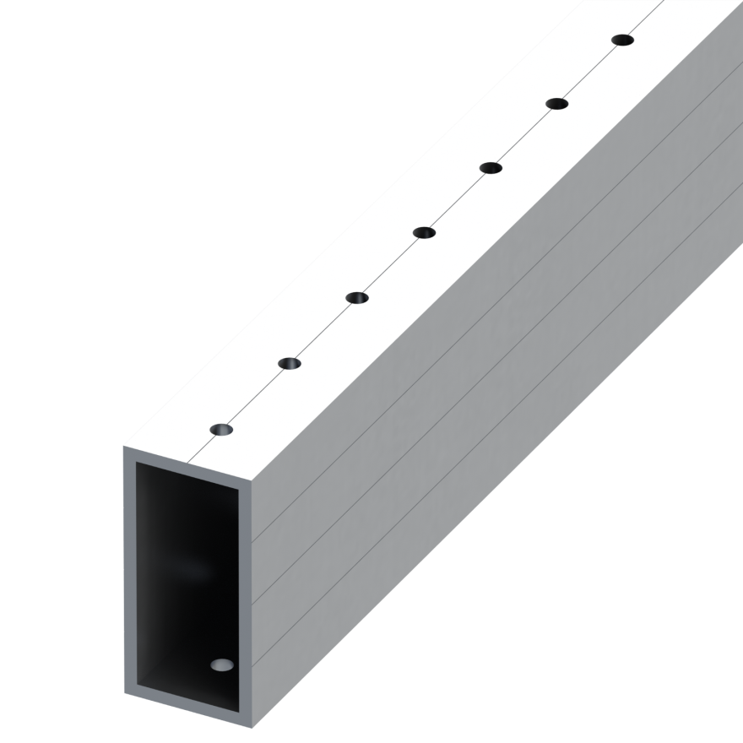
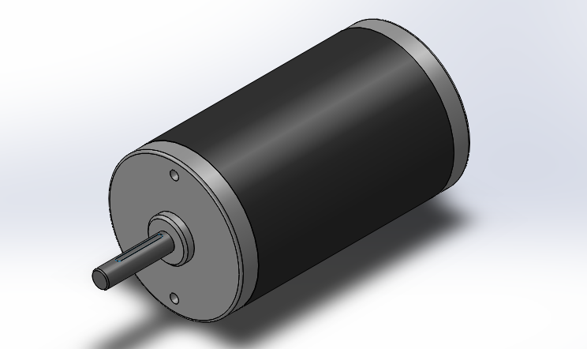
SolidWorks File: Part
Part
Individual component
Can be assigned different properties (color, density, material)

Slide 6
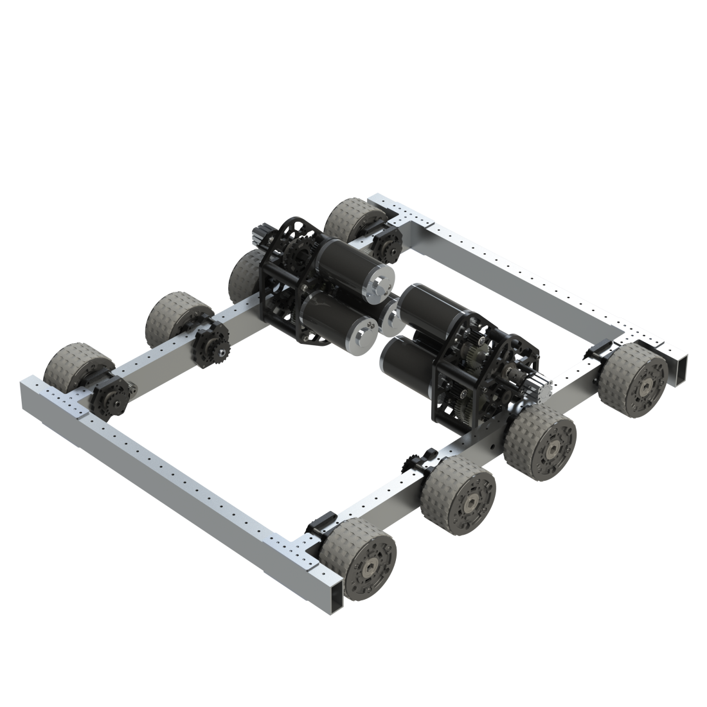
SolidWorks Assembly
Assembly
Made up of Parts
Can be rigged to move just like the real mechanism

Slide 7
CAD File Types
SolidWorks
Non-SolidWorks Software
[Part].SLDPRT
[Assembly].SLDASM
[CAD].STEP

Slide 8
SolidWorks Navigation
Open SolidWorks file named
Swerve-Module.sldasm
Navigate between files by using the buttons on the tool bar

Slide 9
Navigating a Model
Zoom in and out by using the mouse wheel
Pan the camera around the object by pressing down on the mouse wheel and moving the mouse
View orientation button in the top of the viewing area brings up options to view the part head-on from a plane

Slide 10
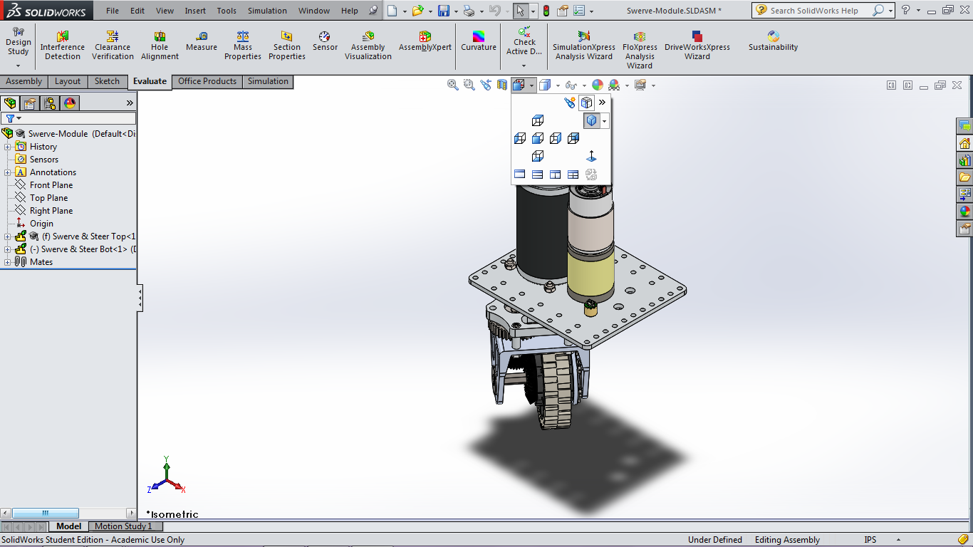
View Orientation

Slide 11
Assembly

Slide 12
Assembly Navigation
The parts and sub-assemblies in the assembly are shown on the left in the Design Tree section
If you click on a part in the assembly, the name of the part will be highlighted in the Design Tree section
Individual parts and sub-assemblies can be opened by right-clicking on the part names or the parts in the assembly and clicking “Open Assembly” or “Open Part”
If the Design Tree section is beginning to get overcrowded, you can right click in the section and select “Collapse Items”

Slide 13
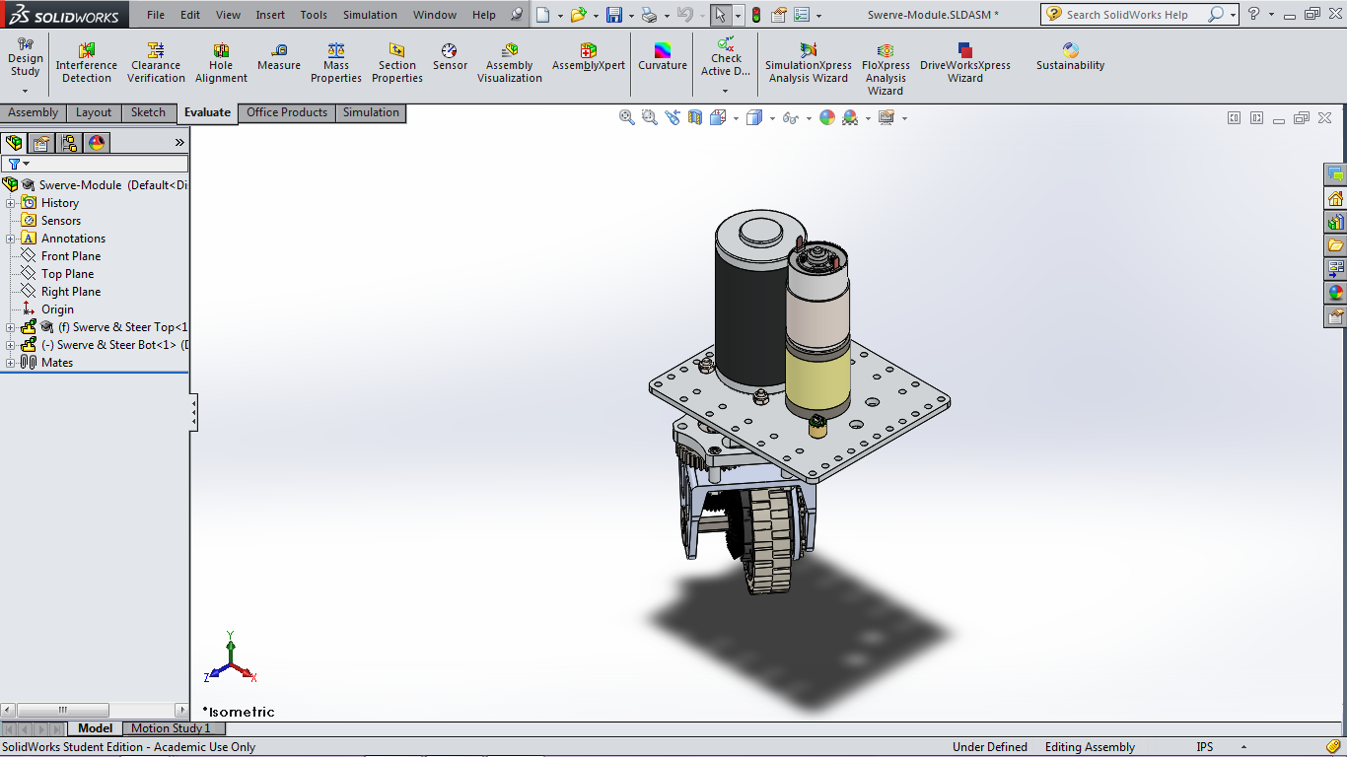
Useful Evaluate Tools
Notes:
15:00 minutes

Slide 14
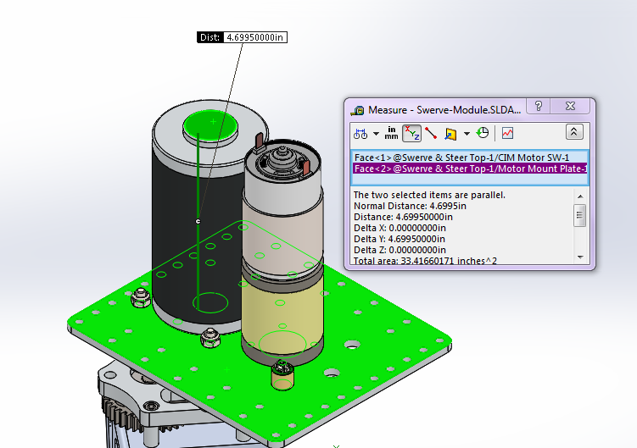
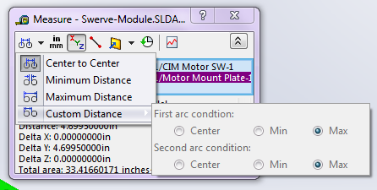
Measure
Measure Tool can find the distances between planes, edges, points, centers of circles, etc.

Slide 15
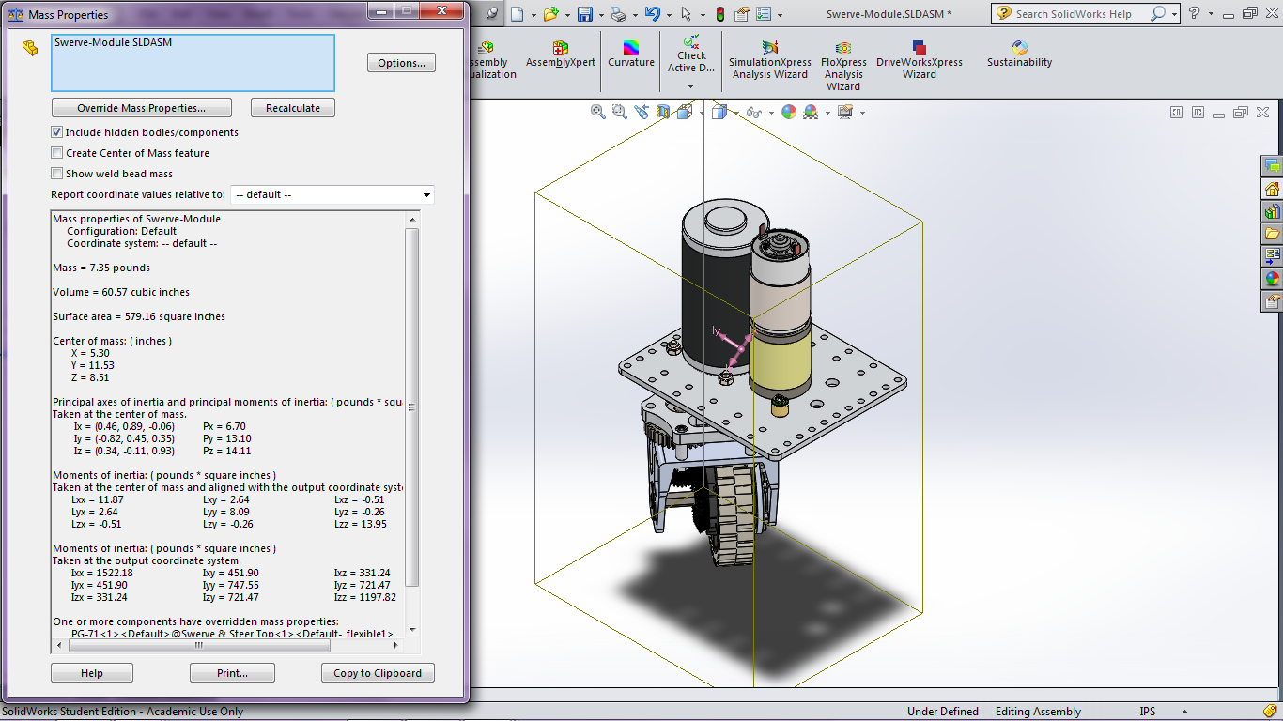
Mass Properties
Mass Properties Tool can find the density, mass, and center of mass of assemblies or selected parts

Slide 16
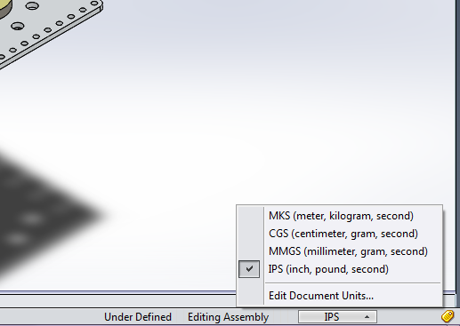
Units
The units that SolidWorks defaults to can be changed by clicking on the button in the bottom right corner

Slide 17
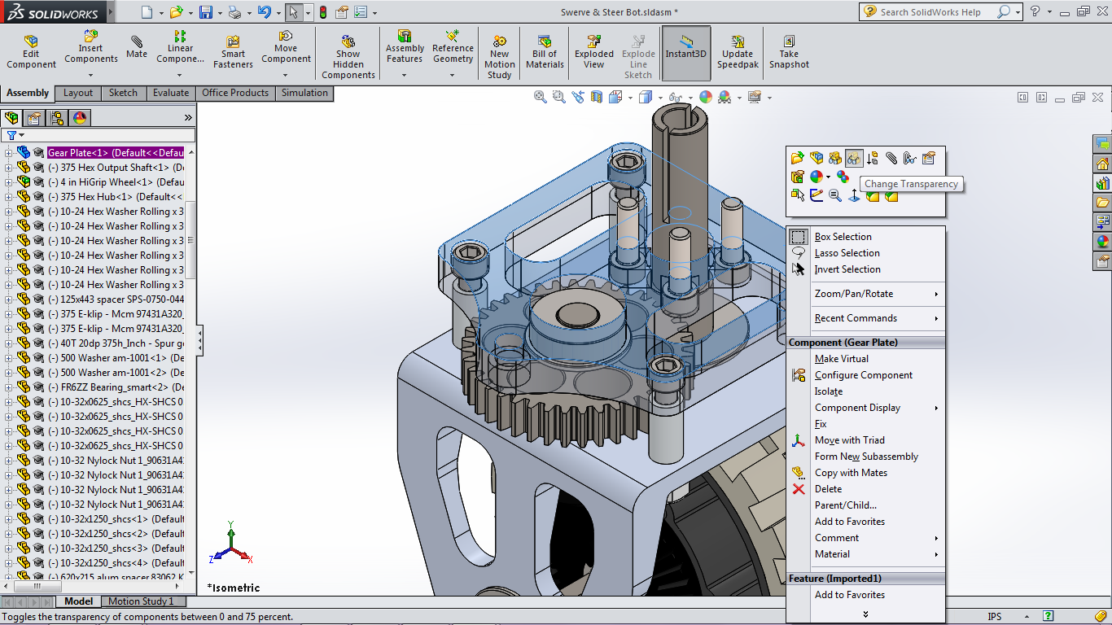
Transparency
Parts in an assembly can be put in a “transparent mode” to allow the user to see other parts that were hidden under it

Slide 18
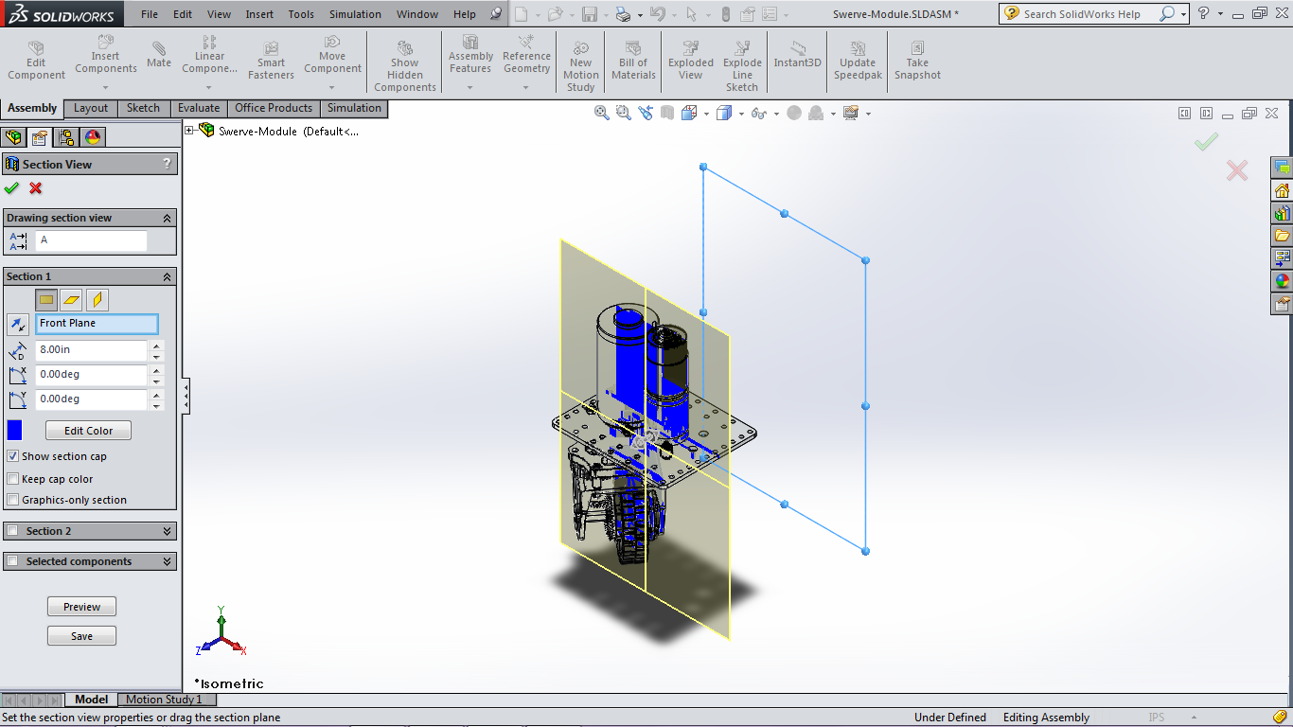
Section View

Slide 19
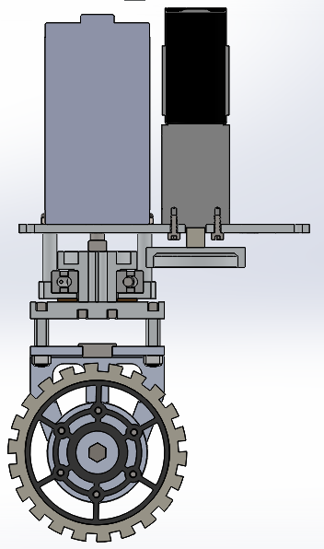
Section View
Section View allows the model to be viewed as if it was “cut” along a plane
Select the plane to cut by changing the reference plane and the distance/angle to that plane

Slide 20
Mates
The basic function in assemblies
Creates a relation between parts such as:
Coincident
Concentric
Tangent
Parallel
Perpendicular
Distance
Angle

Slide 21
Mate Menu

Slide 22
Mate Menu

Slide 23
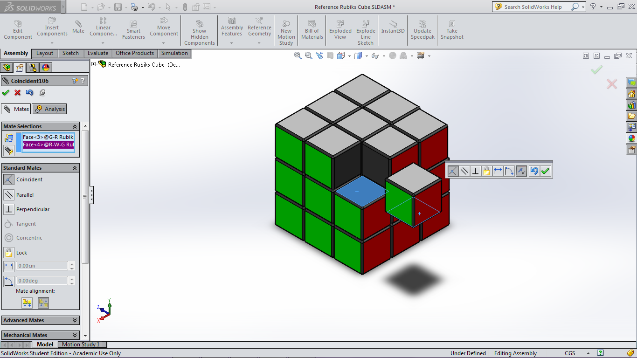
Coincident Mate
Use this mate to put different parts together along a plane or an edge

Slide 24
Coincident Mate

Slide 25
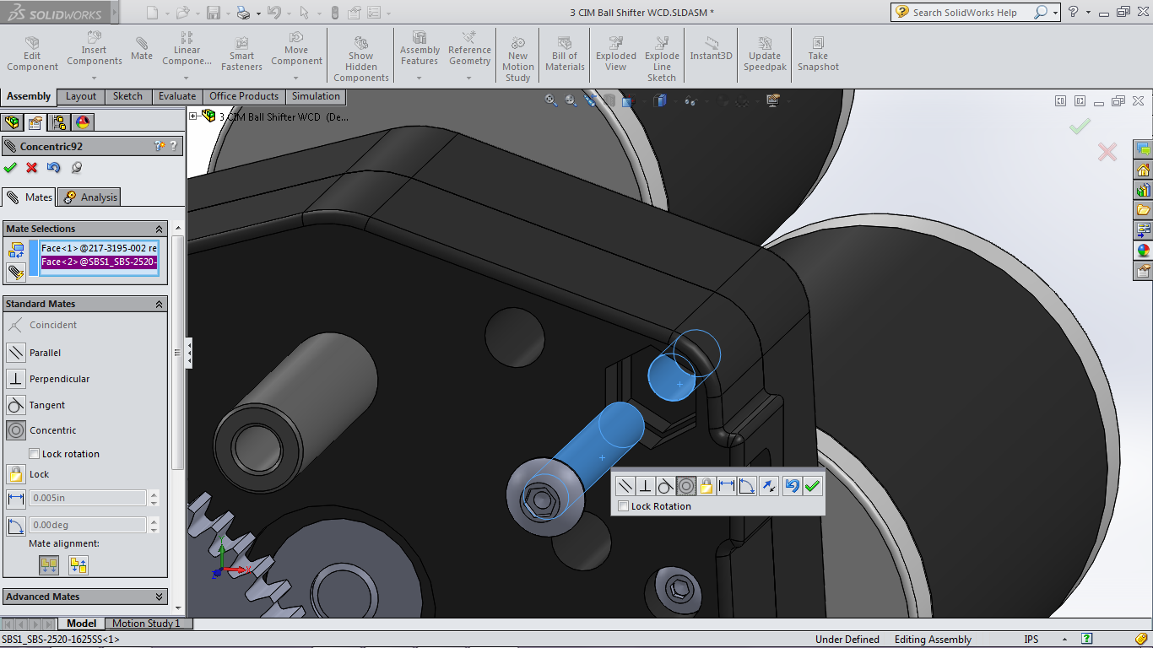
Concentric Mate
Mates two circles so that they are concentric (share the same center)

Slide 26
Concentric Mate

Slide 27
Wheel Assembly
You will now put together a wheel assembly, made up of a wheel, hubs, screws, and nuts
Navigate to CAD Files > Wheel Assembly
You are given instructions in the form of a picture as well as all the parts necessary to put together the wheel assembly in the folder
Put it together!

Slide 28
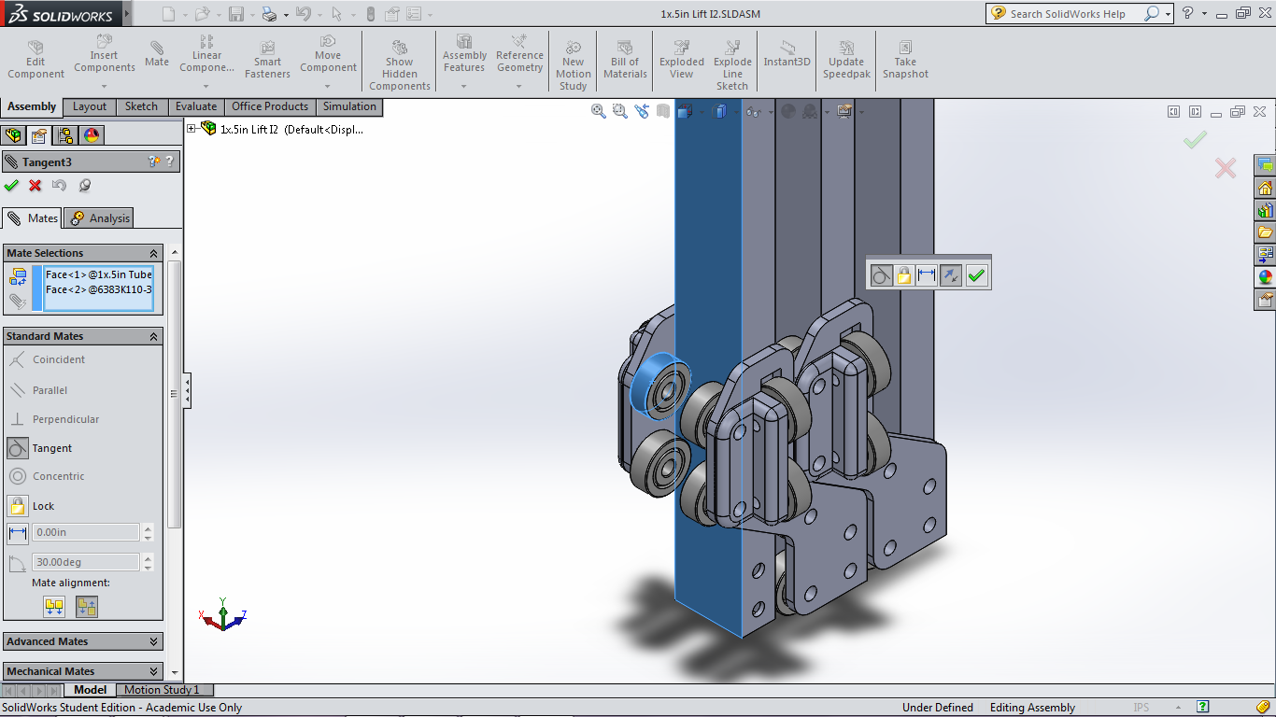
Tangent Mate
Makes a plane tangent to a cylinder/circle

Slide 29
Tangent Mate

Slide 30
Other Standard Mates
Parallel
Makes two planes or edges parallel to each other
Perpendicular
Makes two planes or edges perpendicular to each other
Distance
Sets a static distance between two planes
Angle
Sets a static angle between two planes

Slide 31
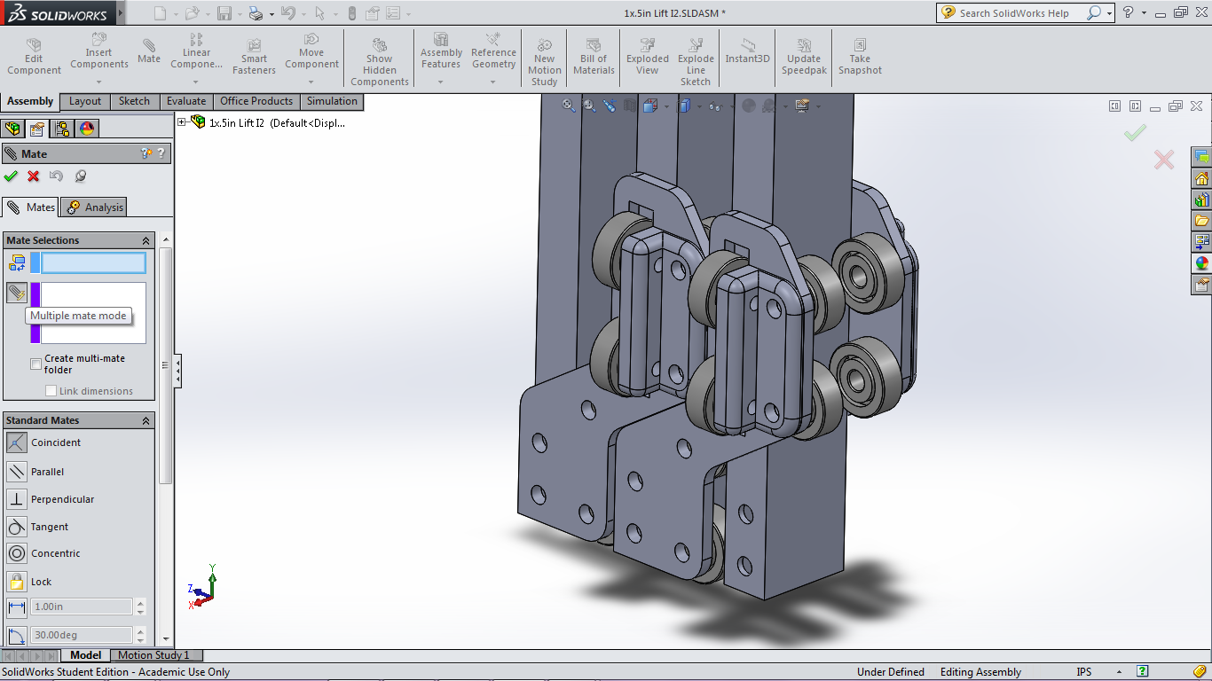
Multiple Mate Option
Useful when mating multiple objects to a single plane
Imagine “putting objects on top of a desk”

Slide 32
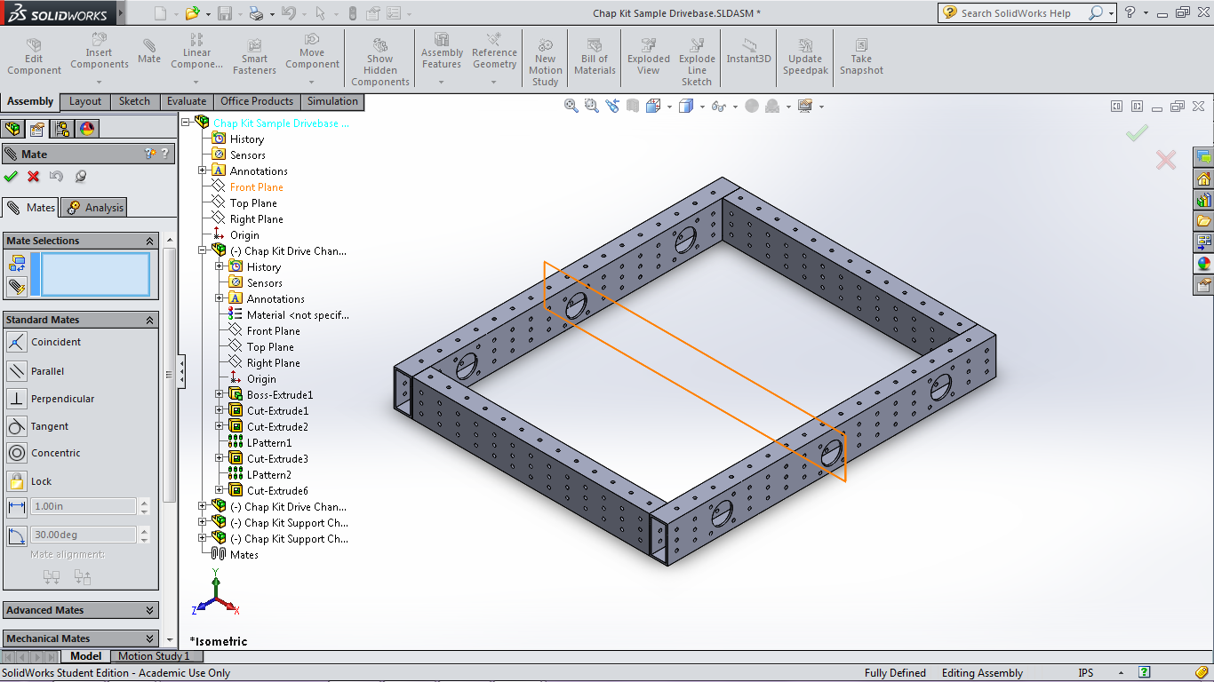
Mating Planes
Planes of the parts and the assembly can be selected by opening the mini-Design Tree when the Mate Menu is open

Slide 33
Advanced Mate

Slide 34
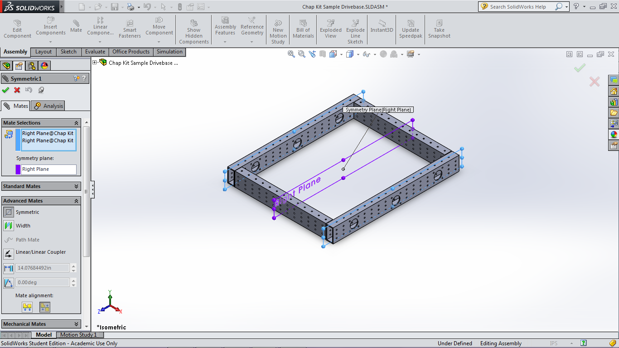
Symmetric Mate
A symmetry plane and two other planes are selected
The other two planes become symmetric across the symmetry plane

Slide 35
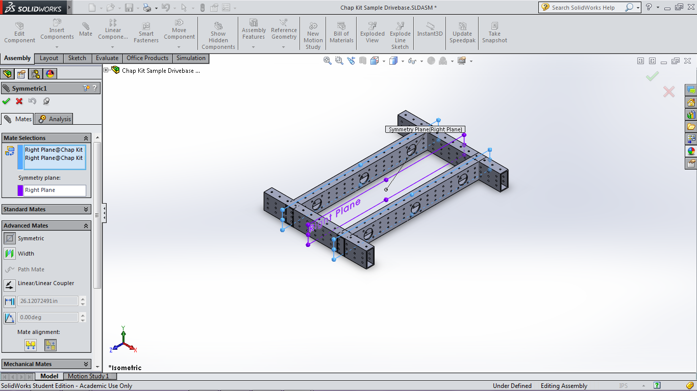
Symmetric Mate
Very useful for assemblies that may change size in the future

Slide 36
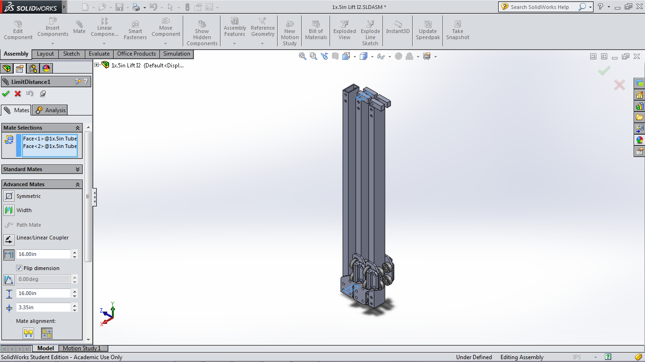
Limit Distance Mate
Sets up limits for the distances that two planes can be at

Slide 37
Distance Limit Mate

Slide 38
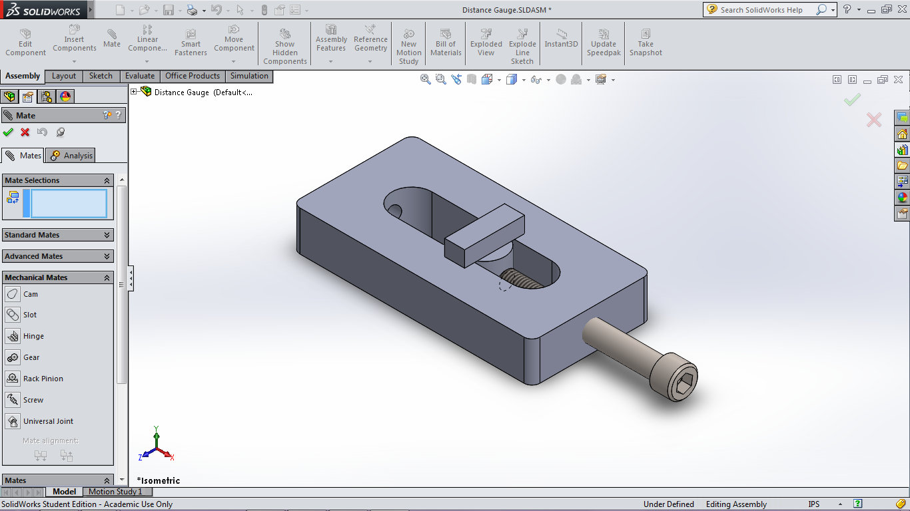
Mechanical Mate
Mates that display functions that are difficult/impossible to show through the Standard and Advanced mates but are often used in mechanical engineering

Slide 39
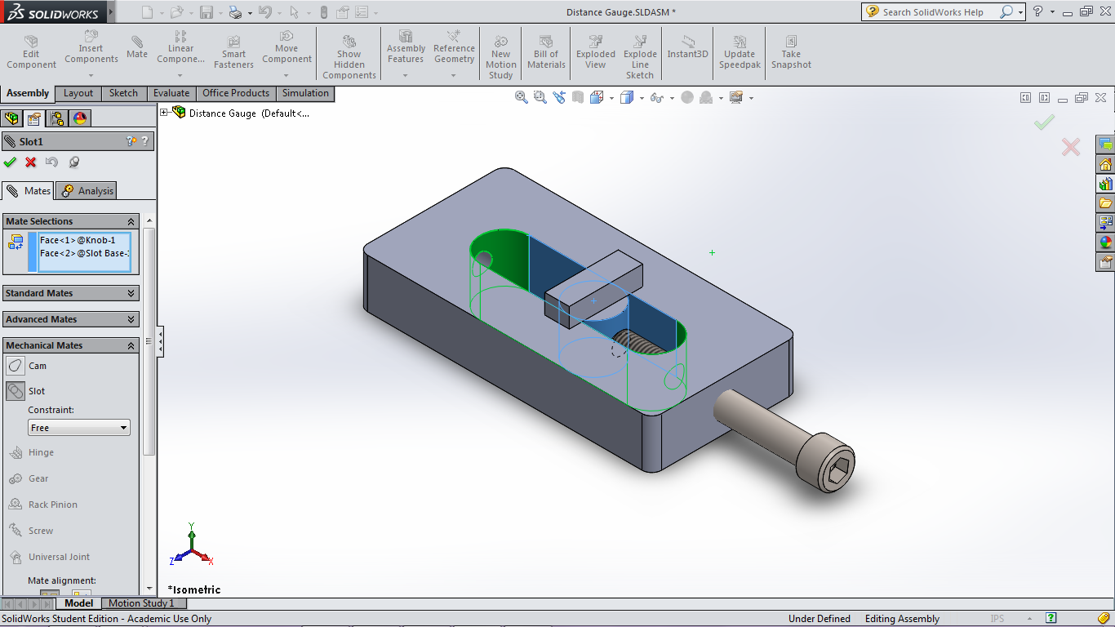
Slot Mate
Similar to the limit distance mate, this mate limits an object so that it can only move within the bounds of a slot

Slide 40
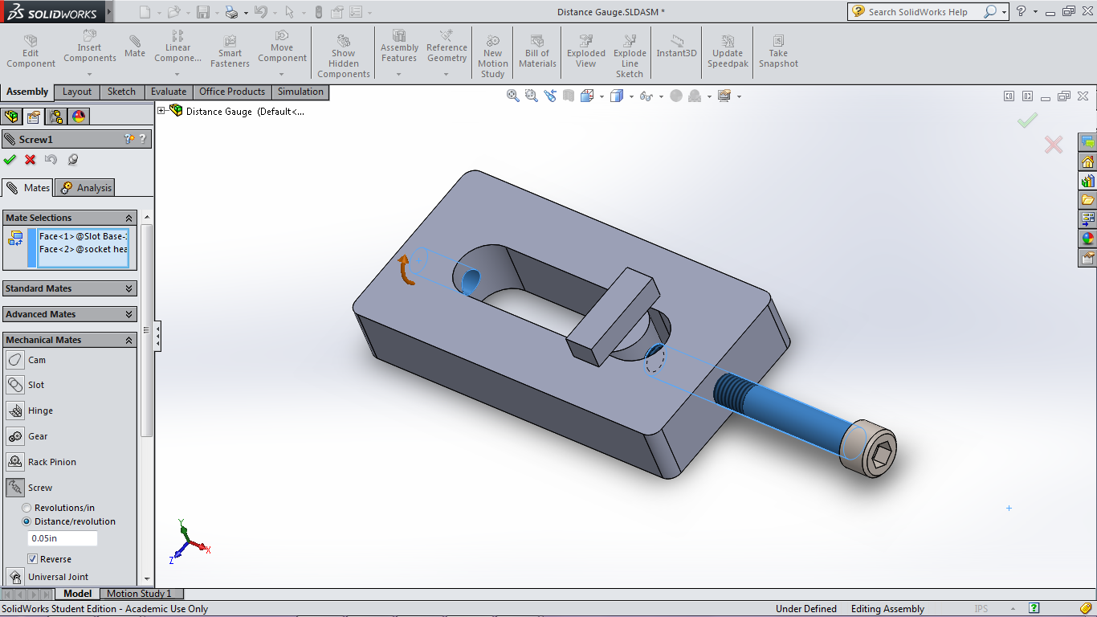
Screw Mate
Set up by selecting a cylinder (a threaded hole in real life) and a rod (a screw/bolt in real life)
Distance per rotation of the screw is inputted and the CAD model prevents movement of the screw model unless it is spun

Slide 41
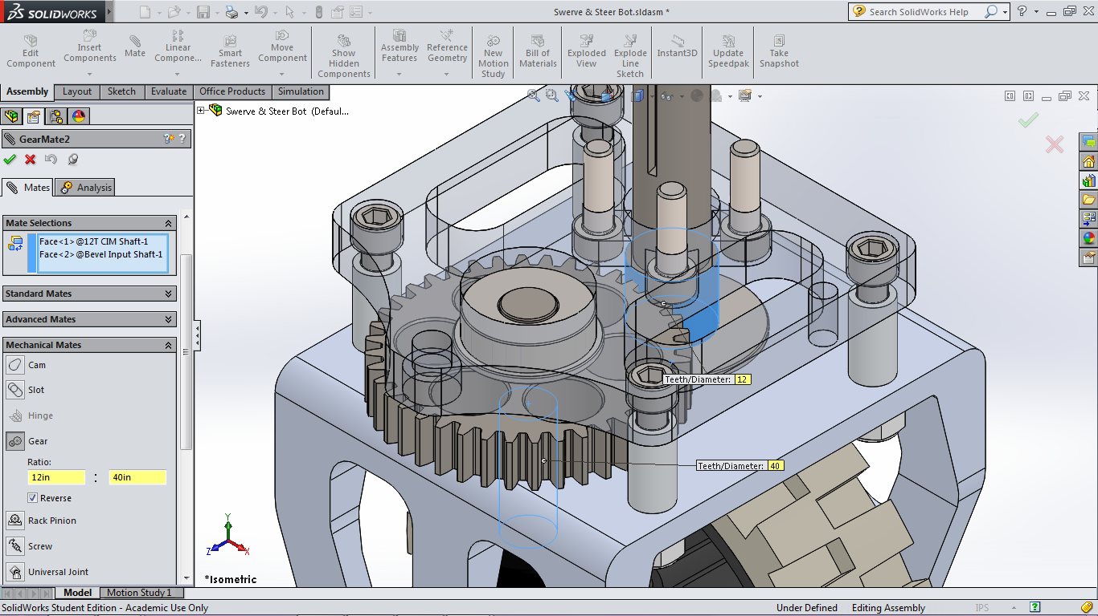
Gear Mate
The diameter of each gear is inputted and the model rigs the gears to spin in sync when one of them spins

Slide 42
Parts

Slide 43
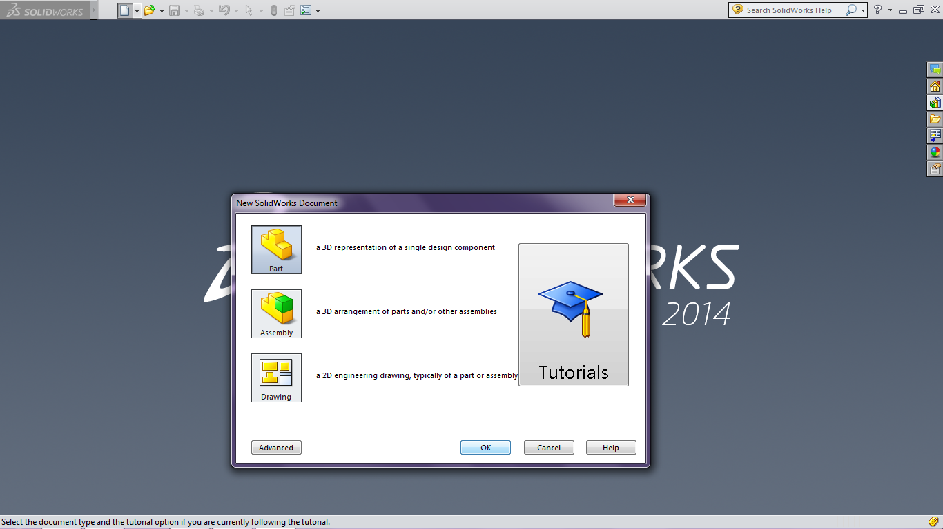
Part Navigation
Open SolidWorks and Click “New” in the top left section of the window
Click “Part” on the window that pops up then “OK”

Slide 44
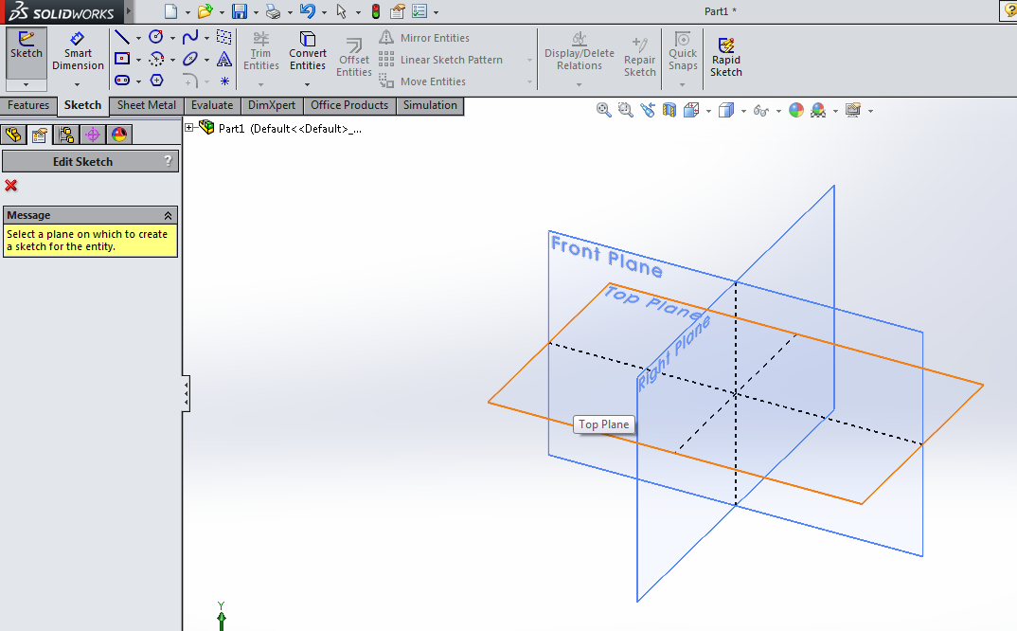
Creating Sketch
Click on “Sketch” in the new tool bar at the top and it should tell you to select a plane
Select the “Top Plane” for now by clicking on the top plane in the 3 dimensional view. You can also select by clicking on “Top Plane” in the design tree

Slide 45
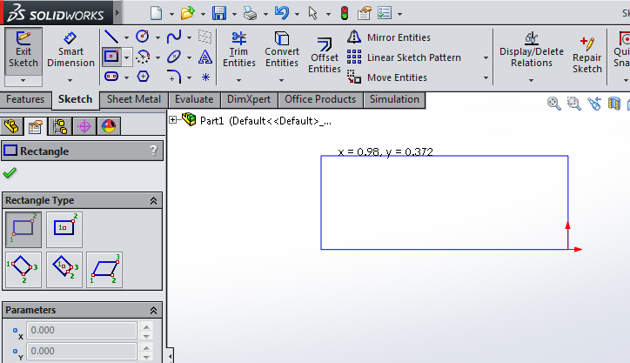
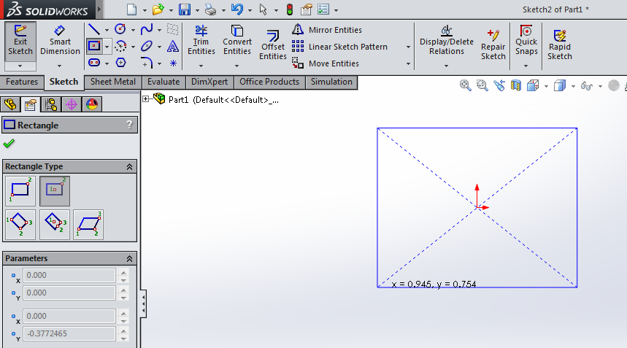
Sketching Tools
On the top is the tool bar with all the different ways to sketch shapes on the plane you have selected
The small downwards pointing triangle next to each item suggests there are different ways of drawing the shape (e.g. Drawing a rectangle)
Different ways to draw can help you immensely in giving the new feature the relation you want with the other entities in the sketch

Slide 46
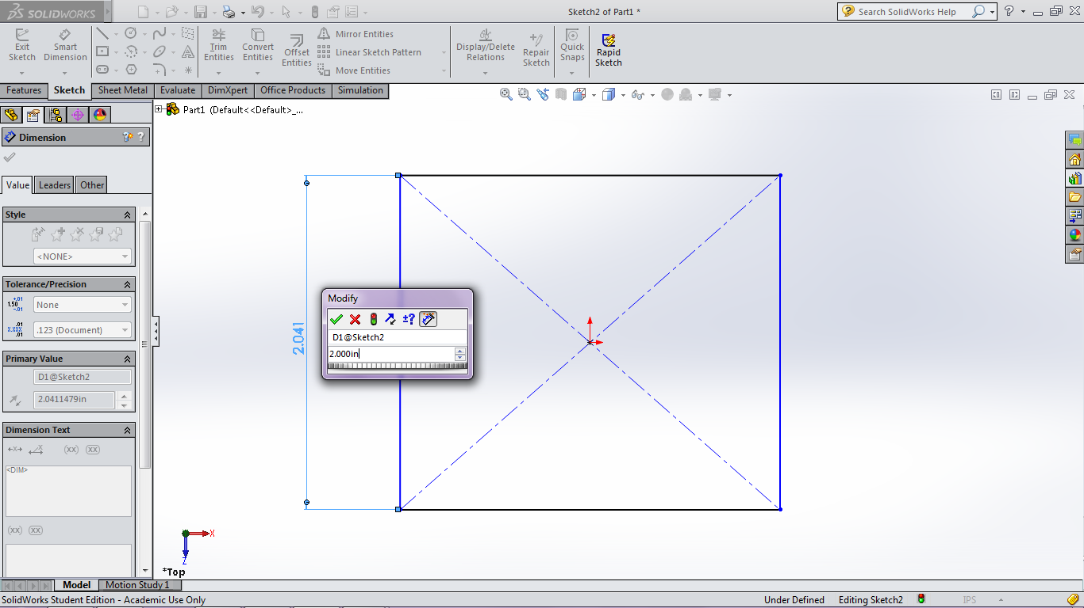
Smart Dimension
Smart Dimension allows the user to set specific dimensions to entities in sketches such as distance, length, diameter, etc.
It’s called smart dimension because YOU need to be smart to use it correctly. If you have the “correct” ones set, changing dimensions in the future would be very easy

Slide 47
Relations
OH MY GOD USE THESE PLEASE!!!
You can set different relationships using this tool and it simplifies a lot of sketches SIGNIFICANTLY
Example on next page…

Slide 48
When you don’t use Relations

Slide 49
When you do Use Relations

Slide 50
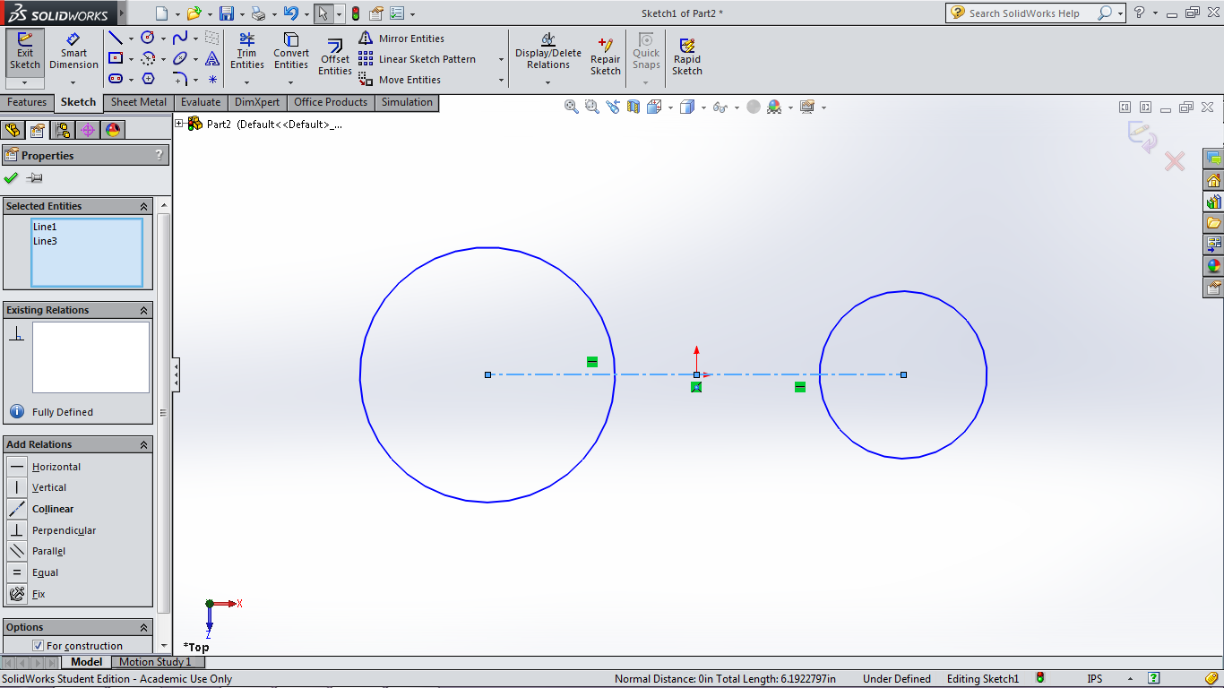
Relations
Click on an entity
Press down CTRL and click on another entity
Select which relation you want

Slide 51
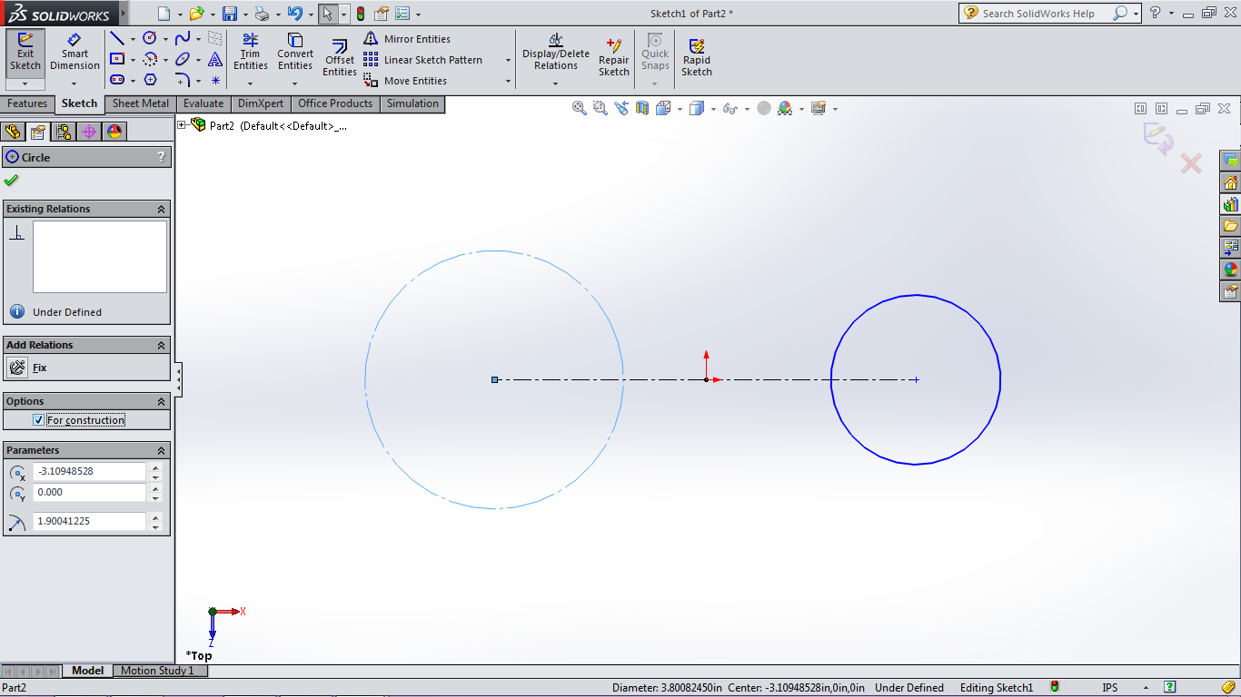
Construction Geometry
When you draw an entity, you don’t always want it in the final product and just need it as a reference.
To change the entity to a “construction geometry”, select the entity and click on the “For Construction” option on the left side

Slide 52
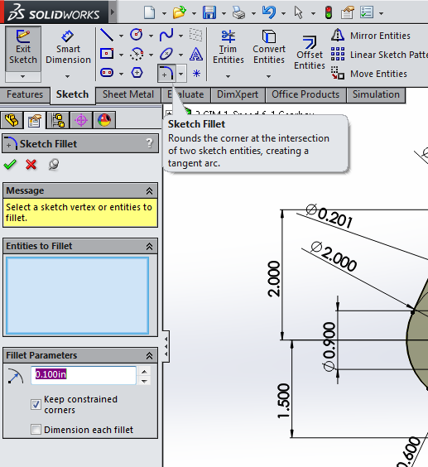
Fillets
Pronounced “fill-et”…
NOT “fill-eh-y”
Smoothes a sharp corner in sketches (you can do it with a 3 dimensional parts too if you want)
Select a point or two lines to fillet the corner

Slide 53
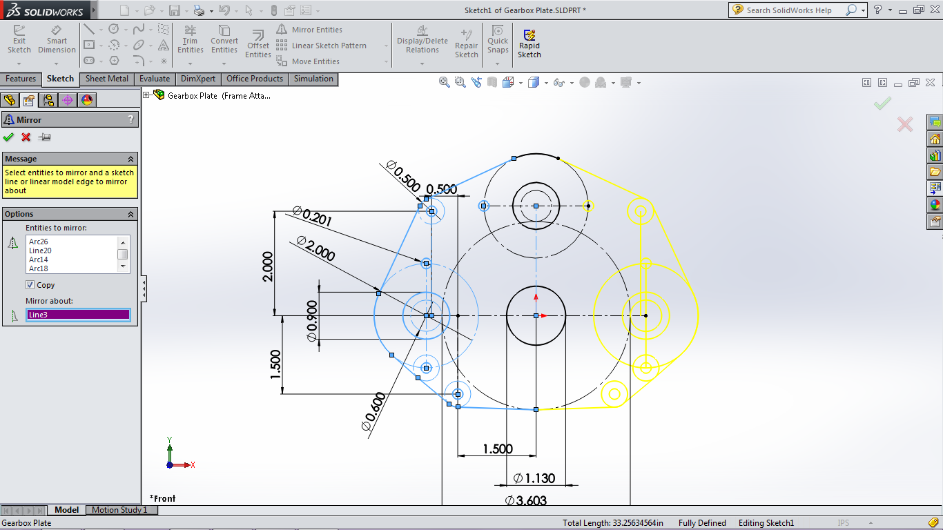
Mirror Entities
Tool that allows selected entities to be mirrored across a line/axis

Slide 54
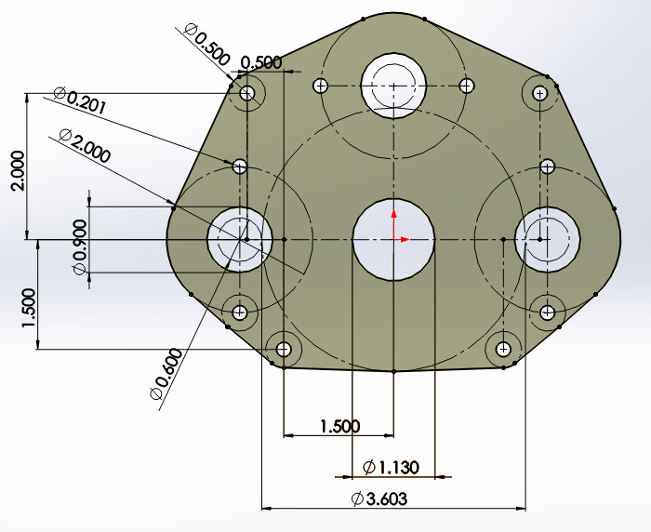
Let’s Try Sketching
Open a new part and put together a sketch that follows the dimensions given in the picture called “Gearbox Plate” on the Front Plane

Slide 55
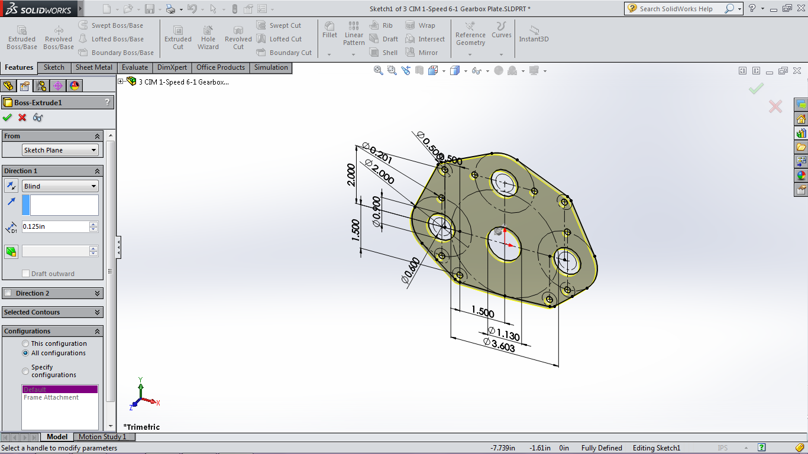
Extruded Boss/Base
Makes a sketch “pop out” and become 3 dimensional
Once your sketch is done, go to the “Features” in the tool bar tabs at top and then click on “Extruded Boss/Base”

Slide 56
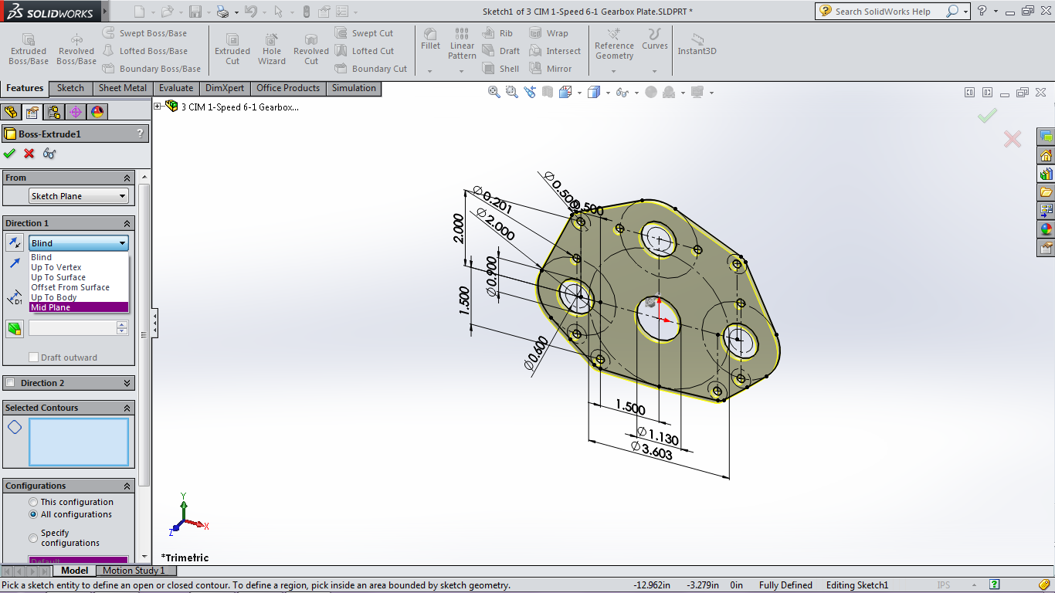
Extruded Boss/Base
In the options, you can set the thickness of the part and the direction the material is extruded
You can also select certain sections to be or not to be extruded using the “Selected Contours” option

Slide 57
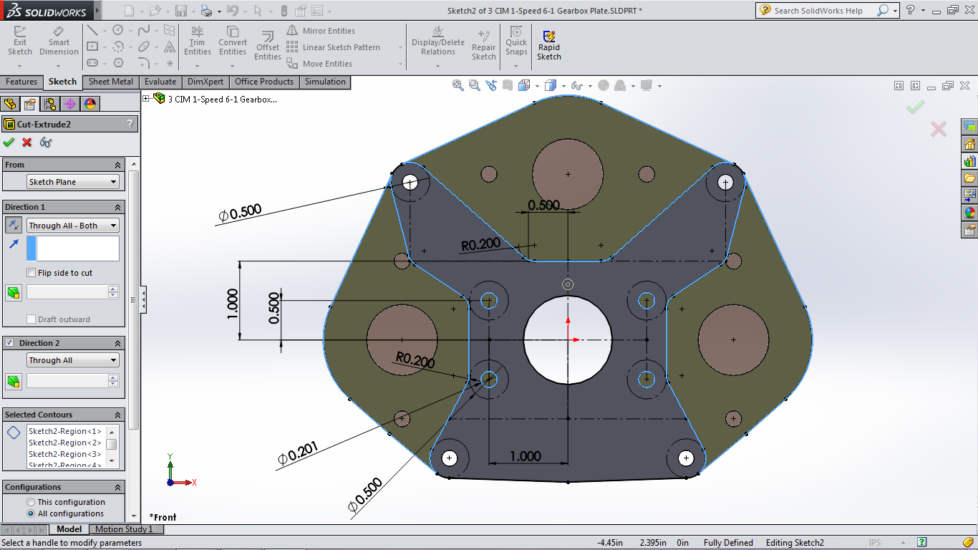
Extruded Cut
Opposite of Extruded Boss/Base
Cut out material from existing part based on a sketch
Options are very similar to Extruded Boss/Base, try to use “Through All” if possible instead of raw dimensions

Slide 58
Configurations
Allows there to be multiple versions of the same part
Dimensions can be shared between different versions
Especially useful for gearbox plates

Slide 59
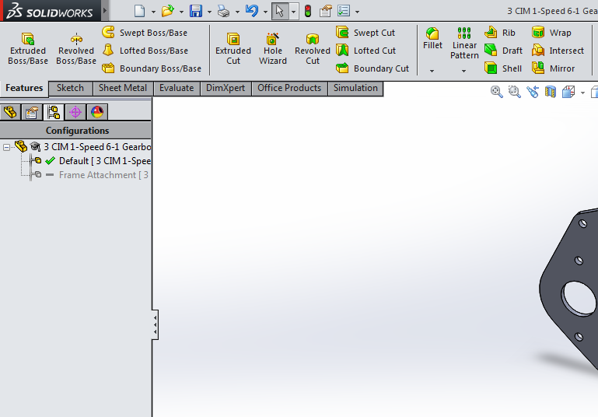
Adding a Configuration
Click on the third tab of the “Design Tree” section on the left side

Slide 60
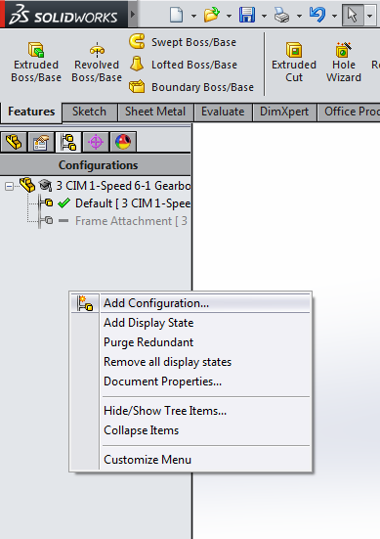
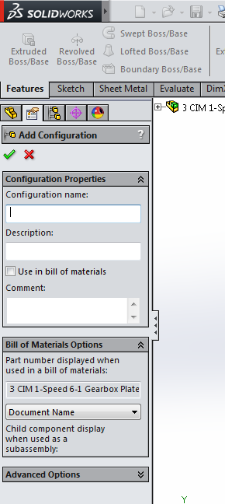
Adding a Configuration
Right click on the parent configuration and click “Add Configuration”

Slide 61
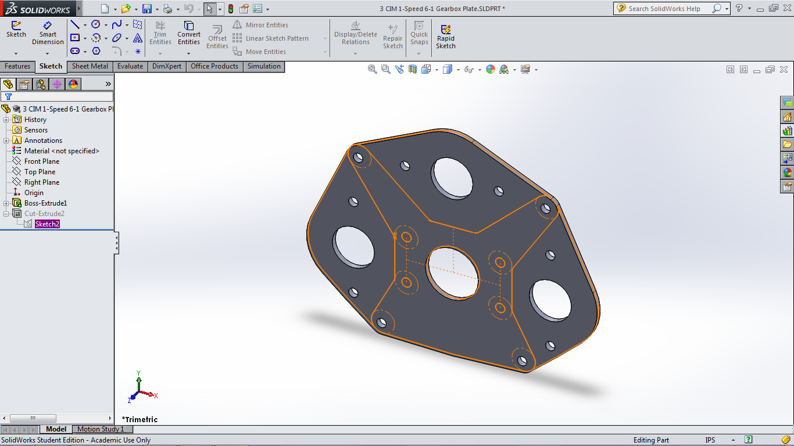
Configurations Tip
In a new configuration, you can add new features or suppress features but all configurations must share the same features

Slide 62
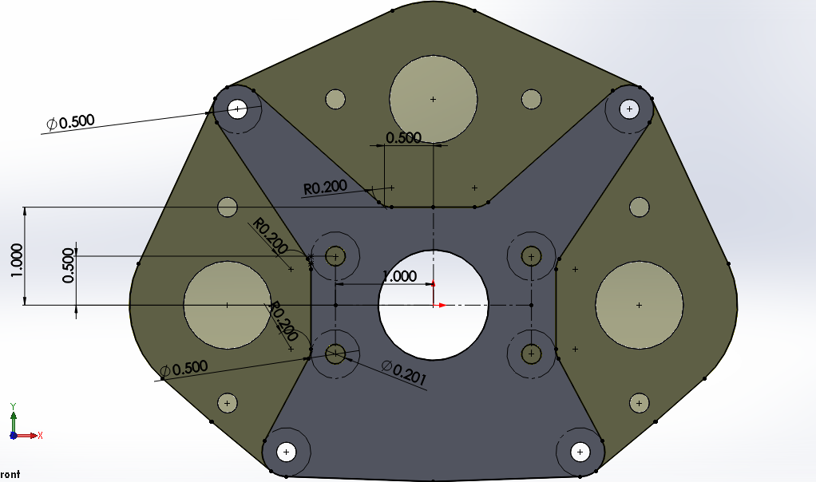
Let’s Try configurations
Make a new configuration called “Frame Attachment” for the gearbox plate
Make cuts to match the dimensions of the reference picture “Frame Attachment”

Slide 63
Complete Gearbox

Slide 64
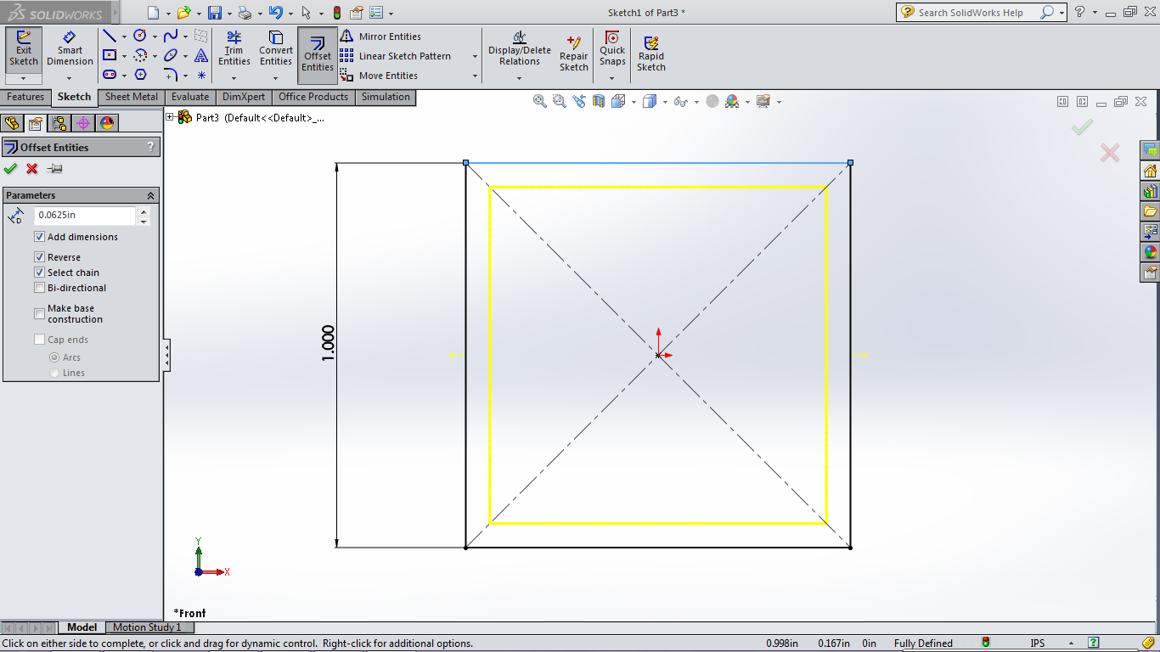
Offset Entities
Creates a parallel line that is offset by a set distance from a previously existing entity

Slide 65
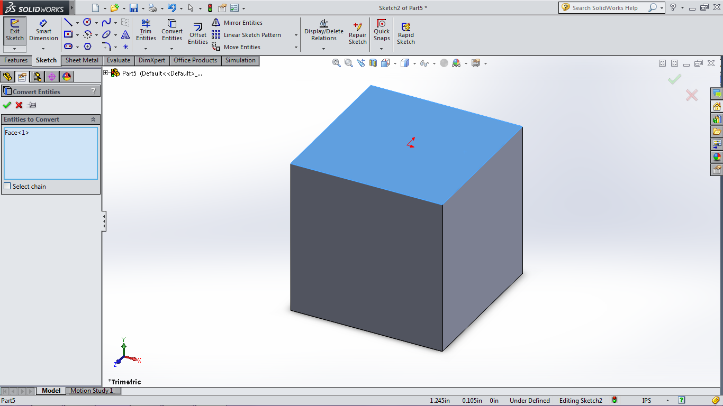
Convert Entity
Converts the outline of features into the sketch that is currently open

Slide 66
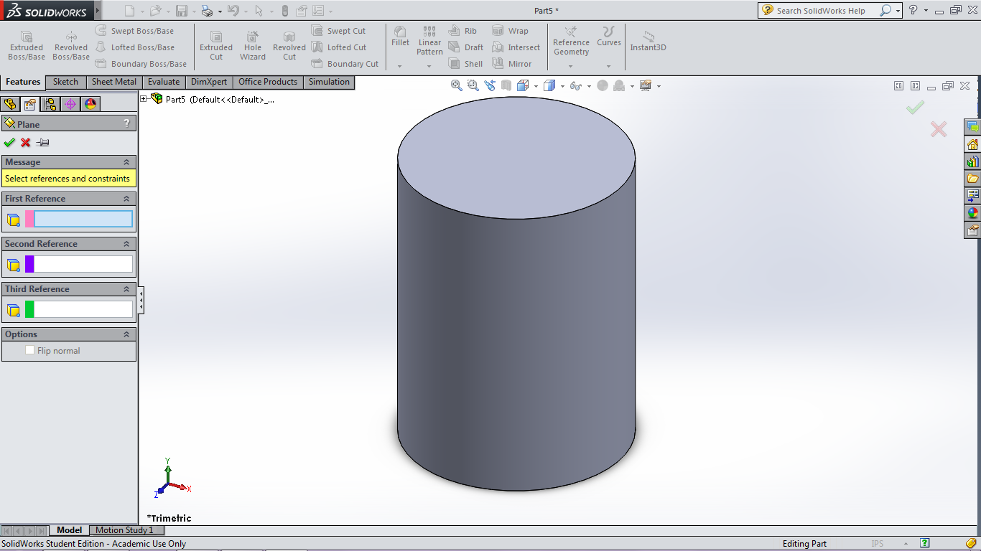
Plane
To create a new plane to sketch on, click on the “Reference Geometry” from the features menu and then “Plane”

Slide 67
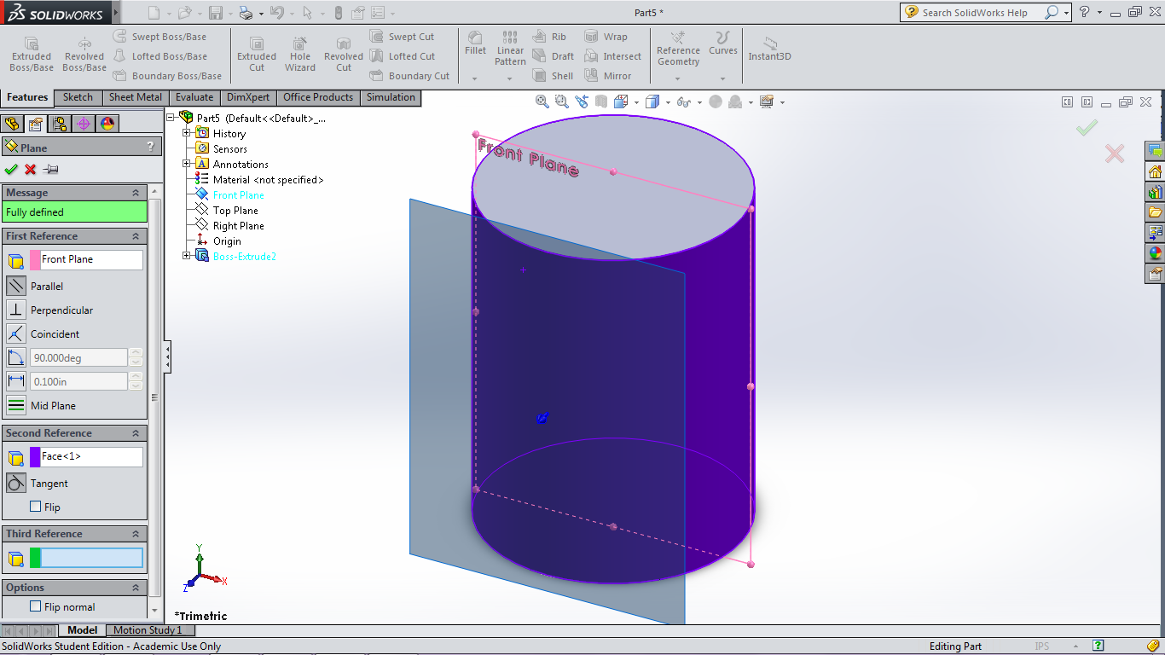
Plane
You can now select existing entities and planes to set the location of the new plane

Slide 68
Plane

Slide 69
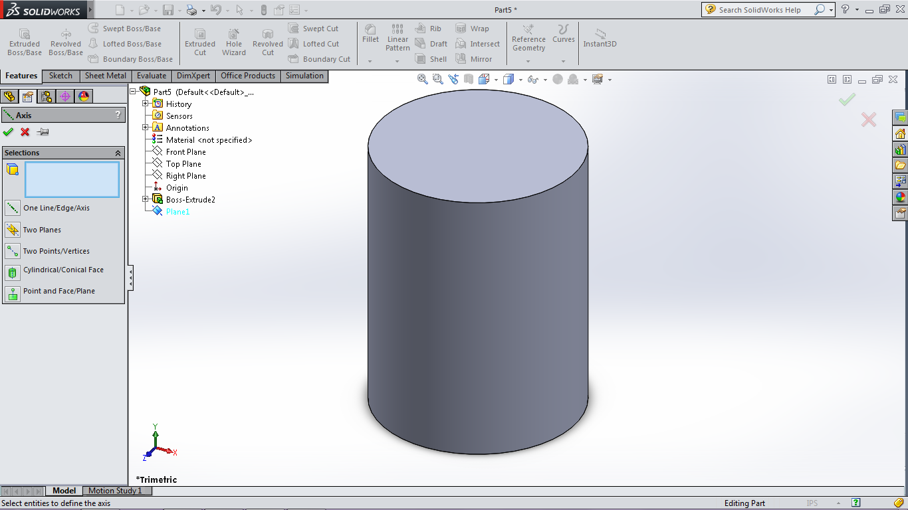
Axis
Creates an axis that can be referenced by features and sketches

Slide 70
Axis

Slide 71
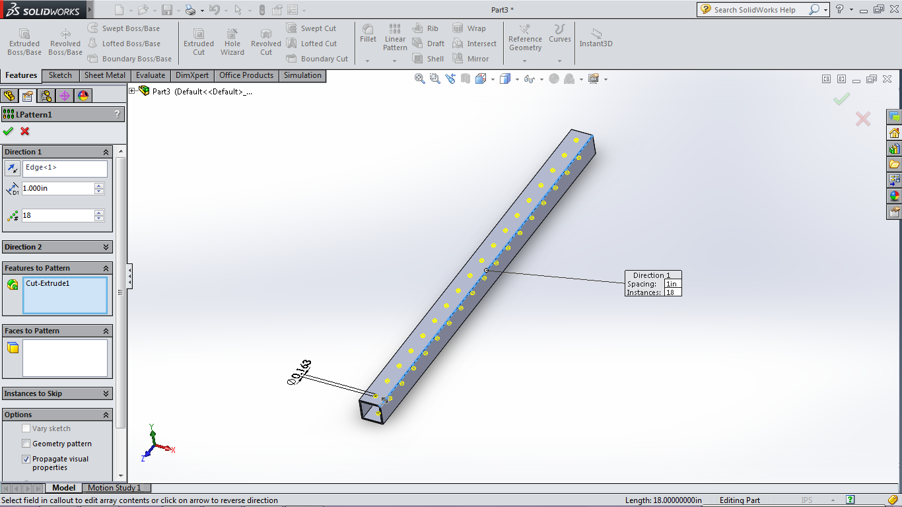
Linear Pattern
Can be done inside the sketch or as a new feature (feature is usually better since configurations can change the number of holes, etc.)

Slide 72
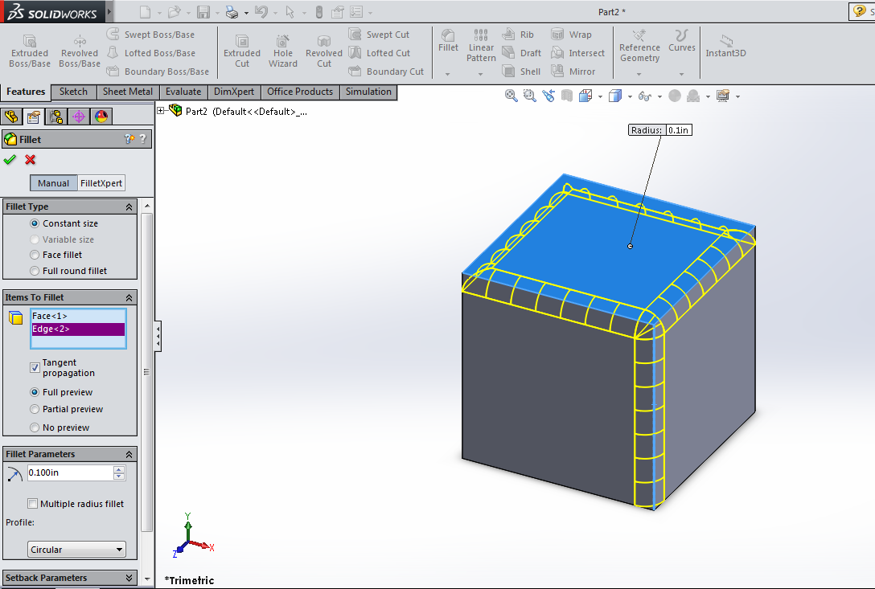
Fillet Feature
Again, Fill-ETS
You should be using this instead of the sketch fillet in most cases

Slide 73
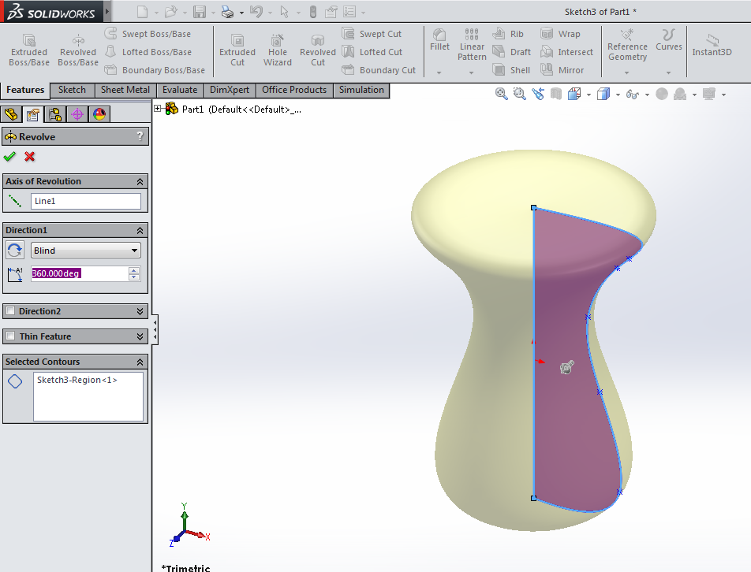
Revolved Boss/Base
How would you create a sphere using extruded boss/base?
It’s impossible
Revolved Boss/Base is used when you want to create something like a sphere or a door knob where the entity is symmetric around an axis

Slide 74
Revolved Cut
Opposite of revolved boss/base
Cuts away material in a circular direction

Slide 75
Revolved Cut

Slide 76
Hole Wizard
SolidWorks puts in a hole with the correct dimensions for the screw/bolt you want to put in the hole

Slide 77
Hole Wizard

Slide 78
Hole Wizard

Slide 79
Hole Wizard

Slide 80
Strategic Design

Slide 81
overview

Slide 82
Strategy
Read the rules, reread the rules, understand the rules
Come up with the best strategy
What action(s) generate the highest score for the least amount of time/work?
Chokehold strategy: A strategy that, if set up correctly, guarantees victory
Remember that defense can be just as effective as offense
Being able to do one action very well, instead of being mediocre at many actions, is almost always better
Always know your limitations! “Elegant” and “Simple” designs are almost always the best!

Slide 83
Actions
Come up with a list of actions that the robot might do for the strategy and mark them as:
Demand
Preferred
Wish
Example:
Robot is able to move: Demand
Robot is able to hold a game piece: Demand
Robot is able to hold 3 game pieces: Preferred
Robot is able to hold 5 game pieces and pick them all up in 10 seconds: Wish
Be quantitative about the actions
How long will it take?
How many game pieces?
How far does the robot travel?

Slide 84
Ring It Up!
Strategies?
Actions?

Slide 85
Drive Train
The most important component of your robot
The most important qualities of drive trains are:
Reliability
Axis's of motion
Resource intensiveness
Simplicity/complexity
Wheel Type
Traction/pneumatic
Omni
Mecanum

Slide 86
Tank Drive
Tank drive
West Coast Drive
Prometheus-style Drive
Four Wheel Drive
Pros
Simple
Effective
Reliable
Pushing Power (Based on number of motors)
Cons
Can’t drive side-ways

Slide 87
Slide/H-Drive
Slide/H-Drive
Made up of omni-wheels facing perpendicular directions
Pros
Fairly Simple
Able to strafe (move sideways)
Fairly Reliable
Cons
No pushing power
Can’t traverse rough terrain/ramps

Slide 88
Mecanum Drive
Mecanum Drive
Made up of (usually) four mecanum wheels
Pros
Simple hardware
Able to strafe
Cons
Difficult programming
Little pushing power
Can’t traverse rough terrain
or ramps
Expensive Wheels

Slide 89
Holonomic Drive
Holonomic Drive
Four omni wheels set up in the corners of the robot with the axles pointing at the corners
Pros
Fairly simple hardware
Able to strafe
Cons
Difficult programming
Little pushing power
Can’t traverse rough terrain
or ramps
Mounting the wheels to be 45 degrees to the frame can be a pain

Slide 90
Swerve Drive
Swerve Drive
Made up of swerve modules where each module can spin the wheels as well as change the direction that the wheels are pointing
Pros
Pushing Power
Able to strafe
Can traverse rough terrain/ramps
Cons
Really complex
Weighs a ton
Can be unreliable
Difficult Programming
EXPENSIVE

Slide 91
Picking a Drive Train
Make a weighted objectives table
5 is great, 1 is bad
Weights are dependent on:
The game
Your strategy
Resources

Slide 92
Picking a Drive Train

