Slide 1
SHEET METAL CONSTRUCTION
Notes:
Talk about what we are going to go over
CAD Files

Slide 2
What is Sheet metal?
Sheets of metal!
Varying thicknesses
0.0625”
0.090”
0.125”
Wide range of uses

Slide 3
Why use sheet metal?
Versatile
Light
Cheap
Fast (with the right machines)

Slide 4
148: Batman and Robin

Slide 5
Why not use sheet metal?
More difficult to use than other methods
Requires a sponsor for larger sheet metal assemblies
More difficult to repair

Slide 6
Demonstration
Layout based part: https://www.youtube.com/watch?v=k5OLCc1Uv24
Profile based part:
https://www.youtube.com/watch?v=CaLFRr8b_Yg
Lightening pattern

Slide 7
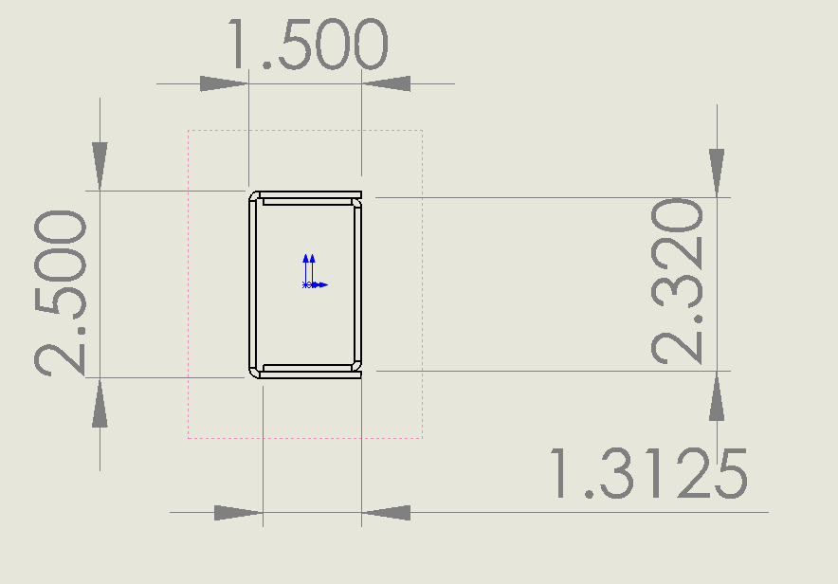
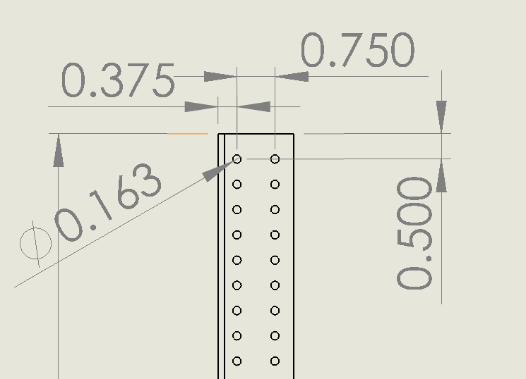
Double-C Channel Tube
0.090” Thickness

Slide 8
FRC 1114 Solidworks Seminar
Sheet metal drive-base step-by-step
On youtube, look up “Simbot SolidWorks Series 6.1”
https://www.youtube.com/watch?v=e-KlNitYwbY

Slide 9
FRC2468.org
Notes:
What will the next step look like?

